Slide 1

EduBotiX

Slide 2




Team Slide
Nithesh M
Nishanth Subramanian E
Mithelesh R
Paravathynathan K
Final year at KGISL Institute of Technology, BE CSE,
Coimbatore, Tamil Nadu, INDIA.
nitheshm1705@gmail.com
Final year at KGISL Institute of Technology, BE CSE,
Coimbatore, Tamil Nadu, INDIA.
nishanth03subramanian@gmail.com
Final year at KGISL Institute of Technology, BE CSE,
Coimbatore, Tamil Nadu, INDIA.
rmithil03@gmail.com
First year at KGISL Institute of Technology, BE CSE,
Coimbatore, Tamil Nadu, INDIA.
aj3681528@gmail.com
Notes:
Please replace photograph with your team member by right click on image > change picture
Please add role and company name and add your email ID.
Feel free to remove extra picture and details if team size is smaller

Slide 3
Problem Statement & Proposed Solution
Solution
Problem
EduBotiX can cover a wide range of tasks that can streamline and automate various processes:
1.For students, EduBotiX assists with tasks such as:
Automating internship searches from websites like Internshala and Naukari.
Assisting in finding events like hackathons , seminars ,webinars.
Assisting through integration with chat GPT for data searching.
2.For teachers, EduBotiX helps with:
Creating meetings on various platforms like Zoom, Webex, Google Meet, and Microsoft Teams.
Collecting attendance data from these meetings.
Sending attendance data to WhatsApp or email.
3.For admins, EduBotiX provides support by:
Creating online meetings.
Sending bulk WhatsApp messages.
Automating the generation of relieving letters and appointment letters.
The world of education is rapidly evolving, demanding innovative solutions to address the diverse needs of students, teachers, and administrators. In this context, there is a pressing need for an intelligent and versatile virtual assistant, to streamline processes and enhance the educational experience.
Problem statement: To develop a bot which helps (Assist) Students,Staff ,Employers & Administration to do their task faster and in an efficient way that can be more secured and easier.
Notes:
Problem: Please briefly mention what is the problem you are trying to solve / what is problem statement Solution: What approach you took to solve the problem/ what is the solution / your solution to the problem

Slide 4
Proposed Solution
Signing in
Voice Support
Writing log file
Online Meeting Creator
Appointment Letter Generator
Relieving Letter Generator
WhatsApp Bulk Message
Hackathon / Event search
Internship search
AI Integration
Teacher/Staff
Administrator
Student
Online Meeting Creator
Whatsapp Bulk Message sender
Attendance Collector

Slide 5
Benefits & Technologies Used
Details
Benefits
End-User | Administrator, Teacher, Students(College/School)
User Department | Educational Department
Industries | Educational industries, This bot is developed in order to help the students,staff and administrators in educational industries.
UiPath Products / Packages | 1. UiPath Studio 2. UiPath Orchestrator 3. Storage Buckets 4. Speech 5. Language Translator 6. UiPath Apps 7. Entities
Other – Integrations / APIs / Technologies Used | 1. Web API(whatsapp) 2. Bard(AI)
The successful implementation of EduBotiX is expected to yield several benefits for educational institutions:
Improved Student Support: Students will have access to automated internship search and event information, enhancing their engagement and opportunities beyond the traditional curriculum.
Streamlined Teacher Facilitation: Teachers will save time on meeting scheduling, attendance tracking, and data distribution, enabling them to focus more on their core responsibilities.
Enhanced Administrative Efficiency: Administrators will experience increased productivity through automated meeting management, mass messaging, and document generation, resulting in smoother administrative operations.
EduBotiX aims to revolutionize the way educational institutions manage day-to-day tasks by leveraging RPA technology. It should empower students, teachers, and administrators with automation, ensuring a more efficient and productive educational ecosystem.
Notes:
Details: Its always good to share details like who is the end-user of your solution, which department/industry will benefit and what technologies have been used.
Benefits: Please include key features / value proposition of your solution

Slide 6
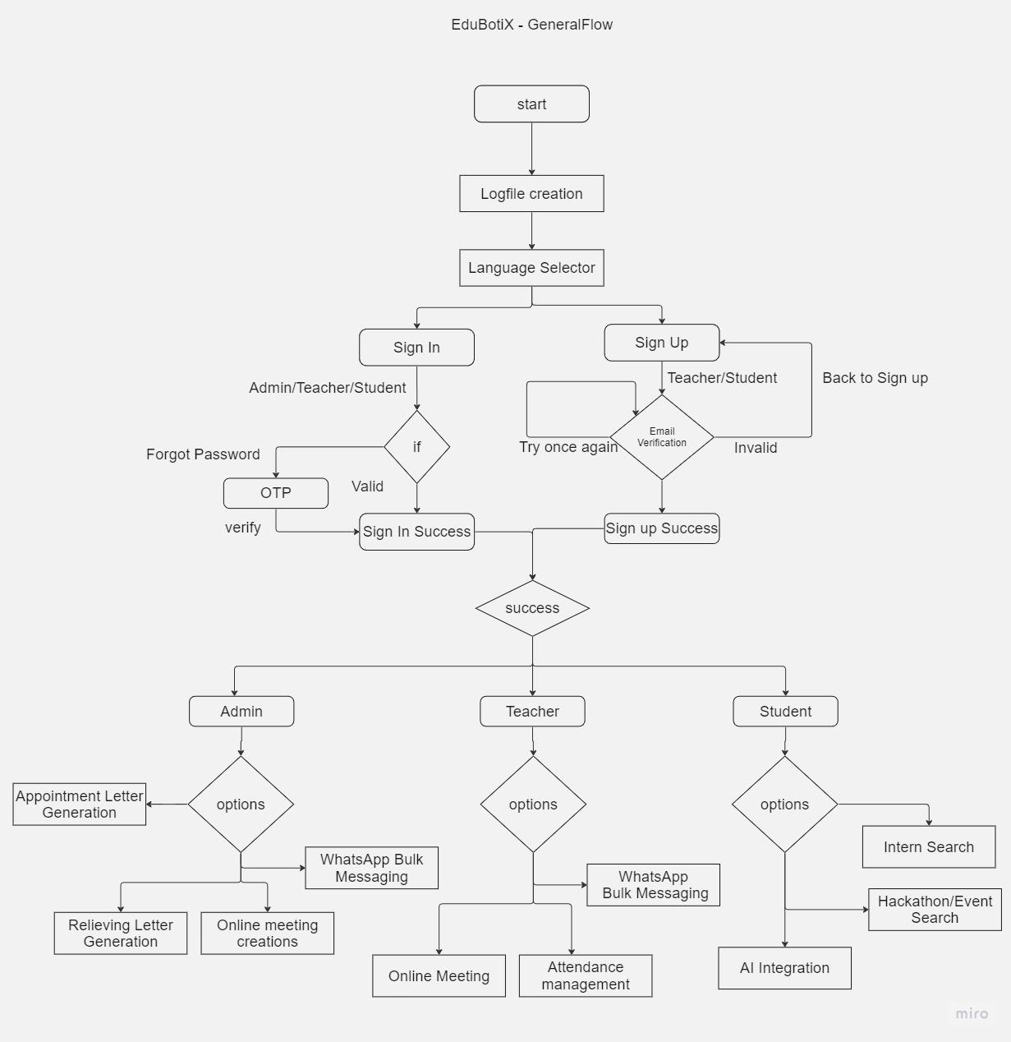
Solution Architecture
Notes:
You can remove the slide if you are not showing Solution Architecture

Slide 7

Solution Architecture
Mind Map:
https://drive.google.com/file/d/10HgfKZUnH_-NHH8riLHSRxY5rUFL2gPE/view?usp=sharing
Flow Chart:
https://drive.google.com/drive/folders/1yu_pcUb9RArYq0mrbK0tc2gk4pi3MSZj?usp=sharing
Outline:
https://drive.google.com/file/d/14J3gKsZbmepbAzqBaxKuEMIzarAf59eD/view?usp=sharing
Demo:
https://drive.google.com/file/d/1HoLr0U6UdHBhliU0BzzGGFYsbXiIpKXn/view?usp=sharing
Notes:
u

Slide 8
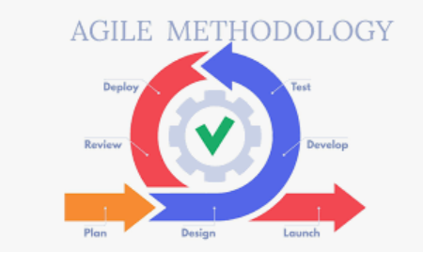

Agility And Future Enhancement
“Embrace change”
The EduBotiX is build by combining various modules which improves the fault tolerance and reduces the chances of error occurrence.
Our project allows to adapt to the changing environment around the users in the forecomming vuca world.
This project is developed with agile methodology
Future enhancement:
To publish in market place to avail our business solution to the world.
Build a User Manual, to use our bot more efficiently.
To include Speech recognition in order to provide better user experience.

Slide 9
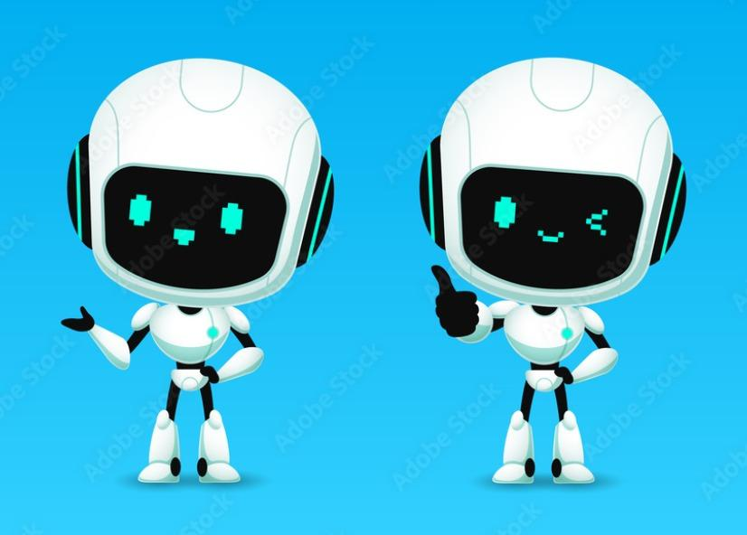
Thank you

